Slide 1
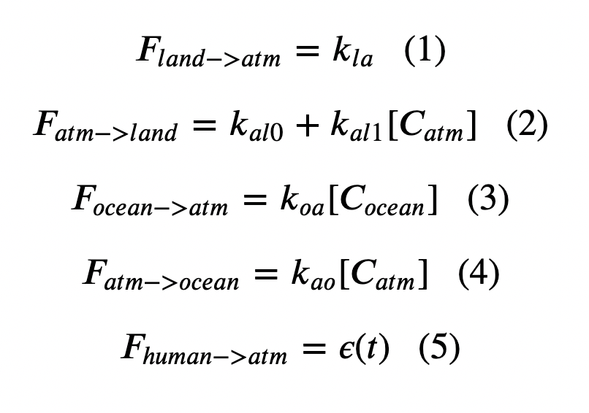
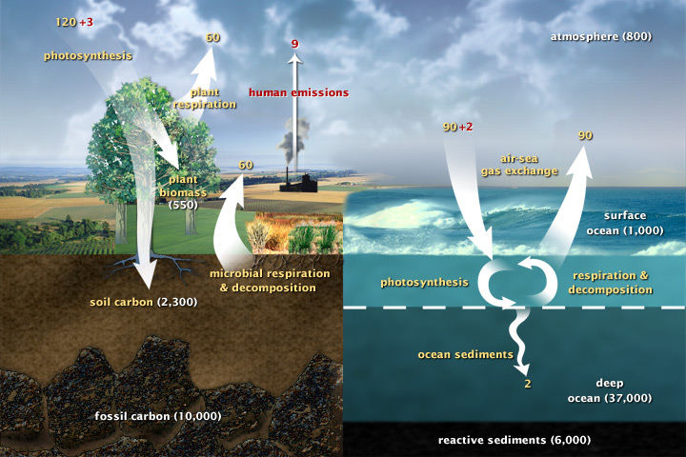
Week 6: Set forth Cambio 1.0 Equations, and how to solve them with Euler’s method
Inside the Euler loop (math):

Slide 2
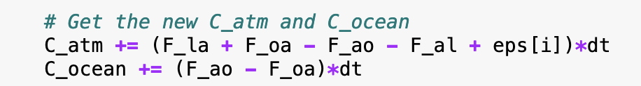
Week 6: Set forth Cambio 1.0 Equations, and how to solve them with Euler’s method
Inside the Euler loop (Python):

Slide 3
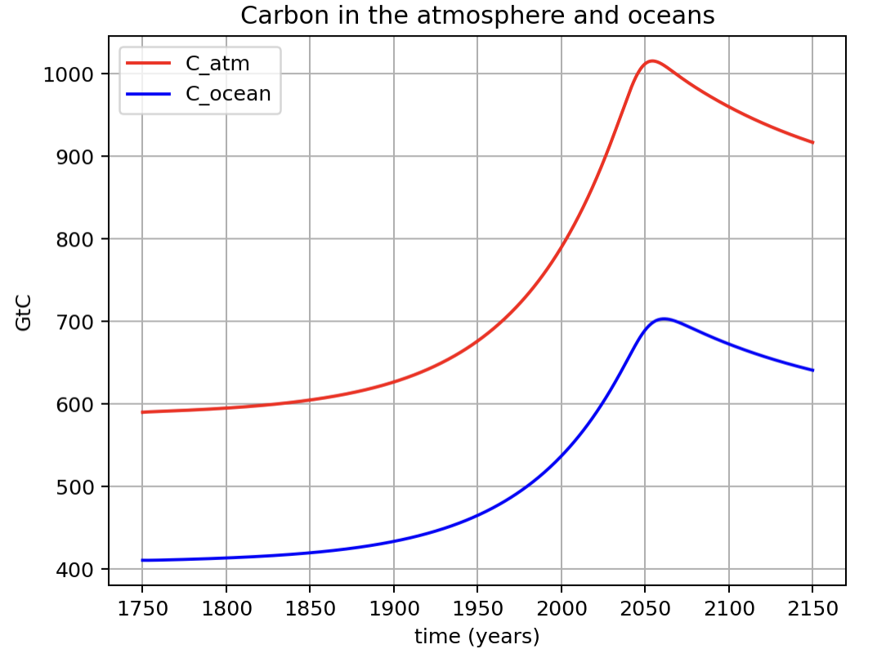
Amounts in the atmosphere and the upper ocean in pre-industrial times
590 GtC in air (pre-industrial)
Pre-industrial carbon amounts
411 GtC in upper ocean (pre-industrial)

Slide 4
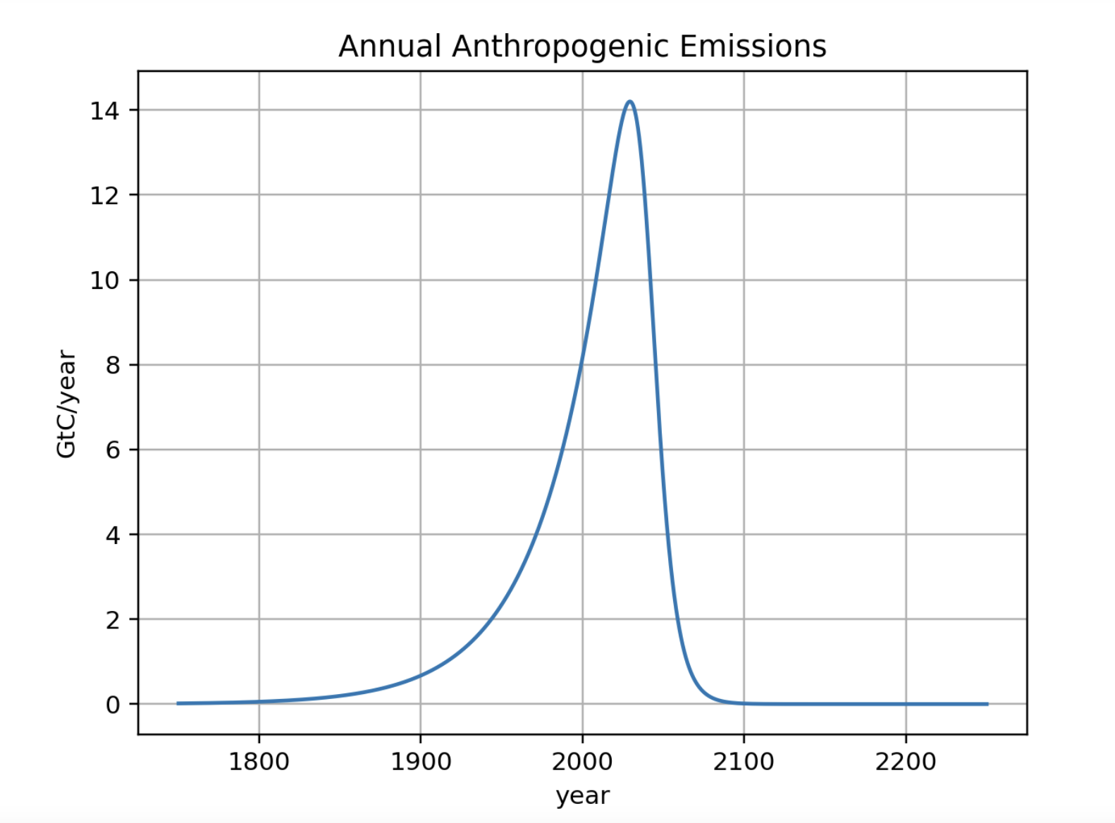
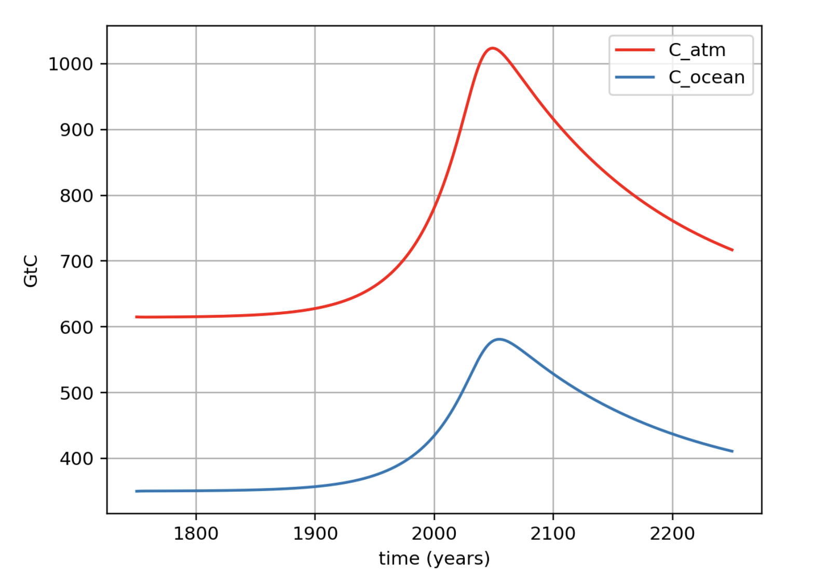
A peek into the output: the time delay between peak emission and peak concentration
For this emissions scenario …
There is this delay …
... here are the amounts of Carbon (GtC) in the climate system.

Slide 5
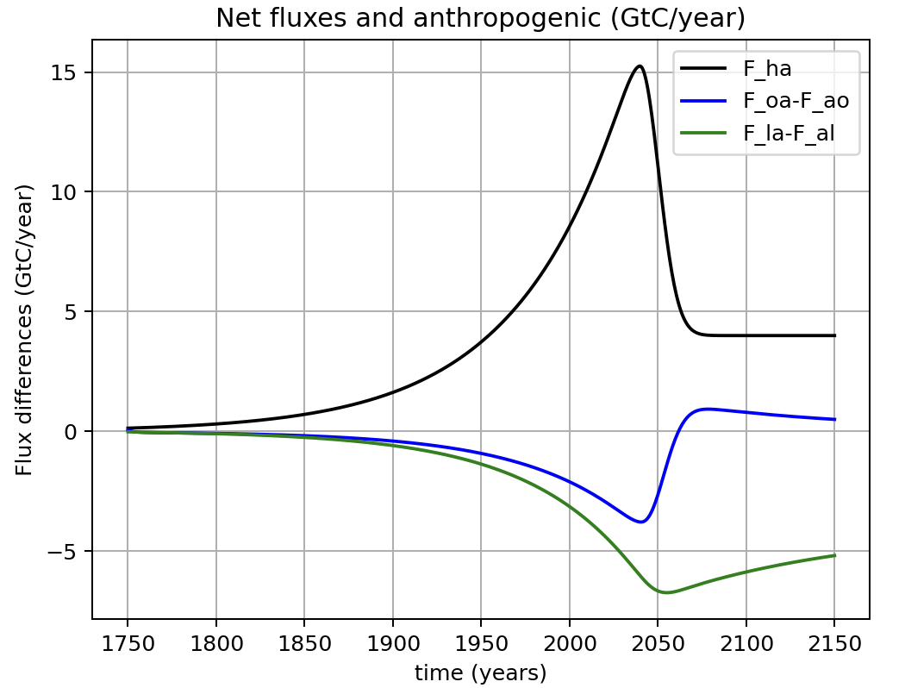
Net fluxes

Slide 6
Net fluxes around the year 2003
9.0 GtC/yr
-2.0 GtC/yr
-3.0 GtC/yr

Slide 7
For comparison with NASA’s Global Carbon Cycle (GCC) diagram (also around year 2003)
Seems like pretty good agreement!

Slide 8
Net fluxes around the year 2003
9.0 GtC/yr
In the year 2003, the percentage of anthropogenic emissions absorbed by the oceans was about 2.0/9.0=0.22 or 22%.
-2.0 GtC/yr
-3.0 GtC/yr

Slide 9
Net fluxes around the year 2003
9.0 GtC/yr
In the year 2003, the percentage of anthropogenic emissions absorbed by the oceans was about 2.0/9.0=0.22 or 22%.
-2.0 GtC/yr
-3.0 GtC/yr
The land absorption was about 3.0/9.0=0.33 or 33% of the anthropogenic emission that year.

Slide 10
But oceans will eventually become sources
However, this graph shows that oceans will eventually (around the year 2060 in this scenario) start to give back their stored CO₂.
So the oceans are more like a lending library for anthropogenic CO₂.

Slide 11
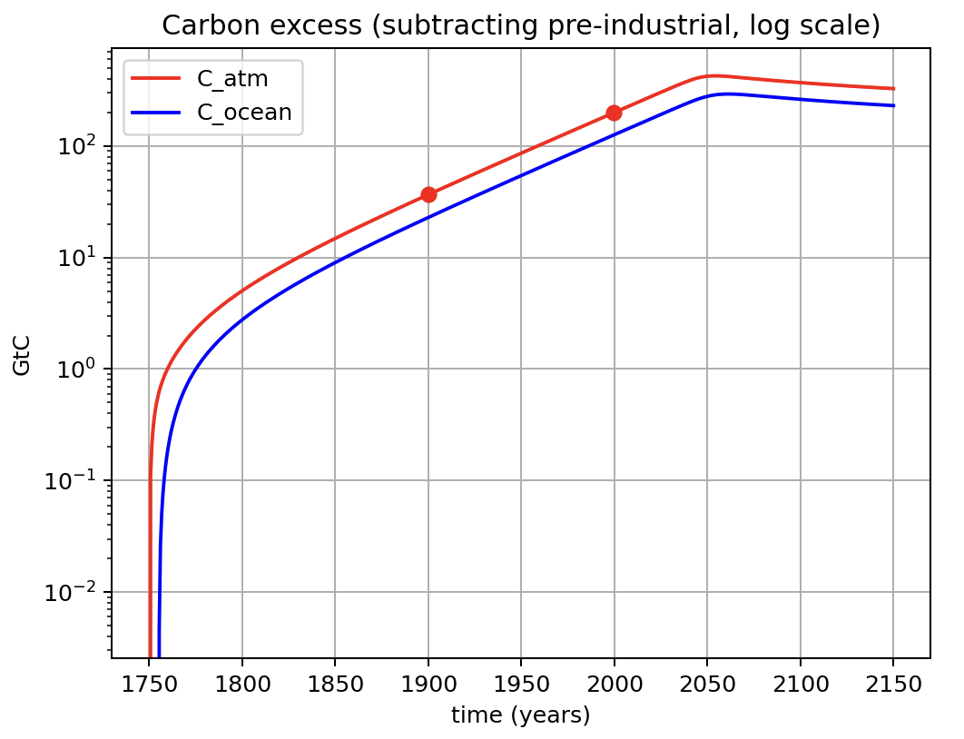
There’s also looking at the excess carbon in the atmosphere and ocean (viewed on a log scale)
Excess C_atm and C_ocean (i.e., the amount those values lie above their pre-industrial amounts). Same timeline, but the vertical axis is a log space.

Slide 12

There’s also looking at the excess carbon in the atmosphere and ocean (viewed on a log scale)
Excess C_atm and C_ocean (i.e., the amount those values lie above their pre-industrial amounts). Same timeline, but the vertical axis is a log space.
And guess what? The slope of the line between the red dots equals $k$ of our emissions scenario!

Slide 13
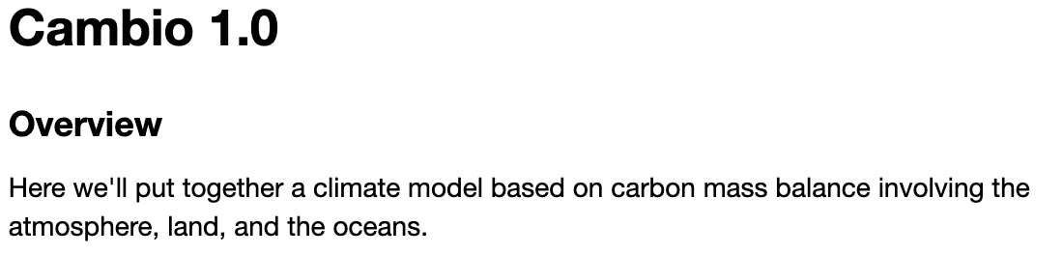
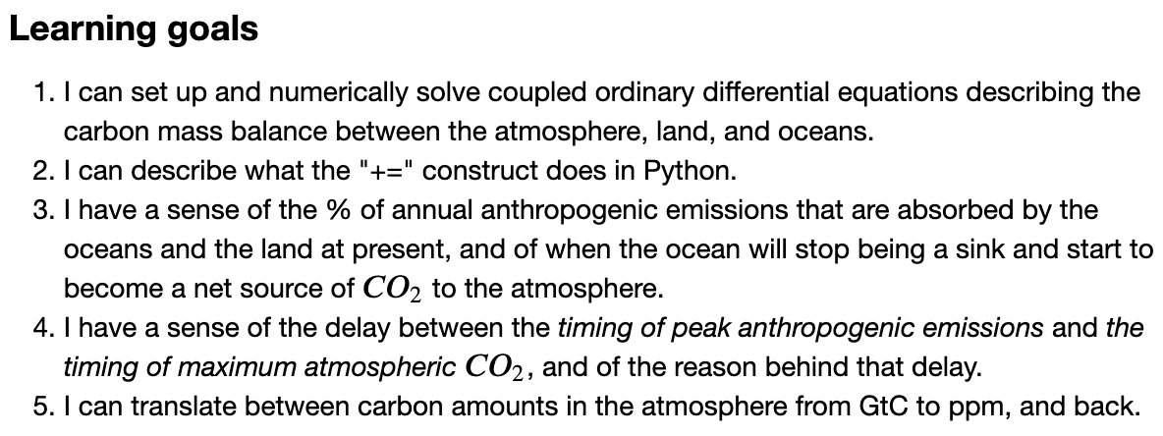
OK, let’s get finish this up

